Slide 1

Diagnoguide: AI-Powered Medical Diagnosis & Guidance System
Under The Guidance Of
External Guide
Prof. Faculty Name
INTERNAL GUIDE
Dr. Hina Chokshi
Developed By
Vidhi Patel (2405102120007)
Parth Patel(2405102120006)
Divy Parekh(2405102120005)
Submitted To:
Parul Institute Of Computer Application
Faculty of IT & Computer Science,
PARUL University

Slide 2
2. About Department of M.Sc.IT
The Department of Master of Computer Application and Master of Science in Information Technology at Parul University emphasizes on building professionals in the domain of computer applications by providing necessary environment by means of facilitating suitable blend of technical and non-technical learning experience. The department cultivates students in various curricular, co-curricular and extra-curricular activities in order to produce future system analysts, system designers, system programmers, application programmers, testing professionals, system managers, project managers, researchers and other leading positions in systems/IT department.
The department of MCA and M.Sc. (IT) focuses on project-based learning, and hence students are motivated to work on tiny hands-on projects in practical oriented subjects to get better exposure. Moreover, throughout their MCA studies, students are required to work on around 3 mini/major projects in individual/team to get enough confidence on software-development and thereby become industry-ready.

Slide 3
3. Project Profile
3.1 Project Definition
The project is a web-based multilingual Disease Prediction System where users enter symptoms to get accurate AI-based disease predictions. It provides medical guidance, suggested medications, and a downloadable digital prescription. The system also uses Google Maps to show nearby hospitals, making it easy for users to get quick medical help. The goal is to offer a simple, accessible tool for early diagnosis and timely treatmenttimely treatment.
3.2 Project Description
The project is a web-based, multilingual Disease Prediction System that identifies possible diseases based on user-entered symptoms using machine learning models. After predicting the condition, the system provides essential medical guidance, basic medication suggestions with a safety disclaimer, and generates a downloadable PDF prescription. It also integrates Google Maps to help users locate nearby hospitals or clinics for quick medical assistance. The multilingual interface ensures accessibility for users from diverse linguistic backgrounds

Slide 4
3. Project Profile
3.3 Scope
This is a globally accessible web application that works on any internet-enabled device through a responsive interface. It is designed for individuals seeking quick, preliminary health advice, allowing them to check symptoms and get instant guidance at any time.
3.4 Objectives
  To predict possible diseases based on user-entered symptoms.
  To offer quick and accessible preliminary medical guidance.
  To provide basic medication suggestions with safety disclaimers.
  To help users locate nearby hospitals through Google Maps integration.
  To generate a downloadable digital prescription for user reference.

Slide 5
4. Existing System & Problem
4.1 Current Issues
Lack of centralized platform for early disease prediction
Existing systems lack accuracy & personalization
Users face information overload while searching online
Limited multilingual solutions for rural users
4.2 Need for New System
AI‑driven predictions improve accuracy
Provides quick preliminary guidance
Multilingual accessibility for wider audience
Hospitals locator helps in emergency situations
Improves self‑awareness & early medical action.

Slide 6
5. Proposed System
5.1 Features
ML-based disease prediction
Multilingual support
Basic medical guidance
Medication suggestions
PDF prescription download
Nearby hospital locator
Responsive, user-friendly interface
5.2 Outcomes
Quick preliminary disease assessment for users
Improved accessibility through multilingual support
Faster decision-making with instant medical guidance
Easy access to nearby hospitals for timely help
Convenient downloadable digital prescription
Enhanced user awareness about symptoms and health conditions

Slide 7
Proposed System
5.3 Project Plan
Task | Planned Dates
Project Definition & Approval | 19th July
Project Profile Submission | 19th July
Requirement Analysis & Design | 18th August
Implementation & UI Development | 18th-23rd Aug 2025
Backend & Database Integration | 23rd – 25th Aug 2025
Testing & Debugging | 27th Aug 2025
Final Report, PPT, Submission | 27th Aug 2025

Slide 8
6. Tools & Technology
6.1 Hardware Requirements
Client-Side:
Any device with a modern web browser
Min 2.0 GHz Dual-Core CPU, 2 GB RAM (Recommended: 4 GB)
Minimal storage, stable internet connection
Display: 1366×768 or higher
Server-Side:
Quad-Core 2.5 GHz+ CPU
4 GB RAM (Recommended: 8 GB+)
10 GB storage for datasets and logs
Supports Python Flask & API integrations
High-speed network

Slide 9
6. Tools & Technology
6.2 Software Requirements
Server / Development:
OS: Windows 10/11, macOS, or Ubuntu 20.04+
Python 3.6+ (Flask, pandas, scikit-learn, Flask-Babel, requests)
Optional DB: SQLite / MySQL
Web Server: Gunicorn / uWSGI with Nginx
APIs: Google Maps API
Client-Side:
HTML5, CSS3, JavaScript
Latest Chrome, Firefox, Edge
Latest versions of Google Chrome, Mozilla Firefox, Microsoft Edge, or Safari.

Slide 10
7. Requirement Analysis
7.1 Feasibility Study
The DiagnoAI System has been carefully analyzed for feasibility across technical, operational, and economic dimensions. The findings indicate that the project is highly feasible and can be implemented effectively using available resources and technology.
7.2 Modules
User Interface
Disease Prediction
Medical Guidance
Medication Suggestions
PDF Prescription
Hospital Locator
Multilingual Support
7.3 Users of the System
General Users: Get symptom-based predictions, guidance, prescription, and hospital info.
Administrators: Update data, maintain system, and ensure accuracy.

Slide 11
7. Requirement Analysis
7.4 Use Cases
UC1: Input Symptoms
User enters/selects symptoms → system collects data.
UC2: Predict Disease
System processes input → ML model predicts disease with confidence score.
UC3: View Precautions
User selects disease → system shows precautions.
UC4: Medication Advice
User enters details → system suggests basic medications + PDF prescription.
UC5: Find Nearby Hospitals
User clicks hospital search → system shows nearby hospitals via Google Maps.
UC6: Change Language
User selects language → interface updates automatically.

Slide 12
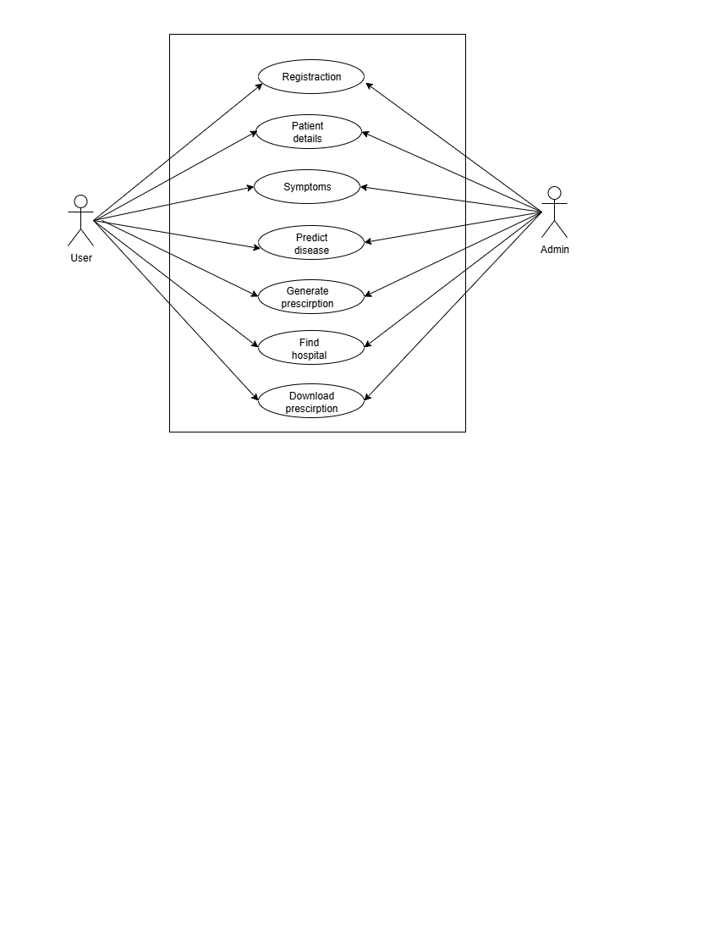
7. Requirement Analysis

Slide 13
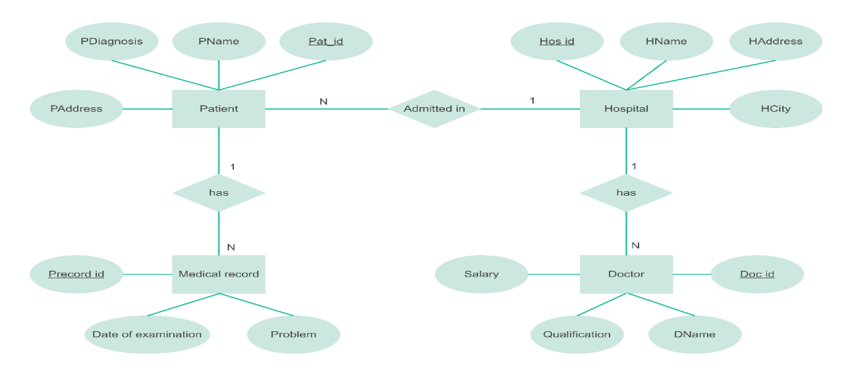
8. System Design
8.1 Entity Relationship Diagram
The ER diagram shows a hospital system where a Patient has basic details and can have multiple Medical Records, each storing examination information. Patients are admitted to a Hospital, which includes hospital details and employs multiple Doctors with their own attributes. The diagram highlights how patients, hospitals, doctors, and medical records are connected for efficient data management.
ER Diagram

Slide 14
8. System Design
8.2 Data Dictionary
The Data Dictionary defines key data elements used in the system, including symptom inputs, user details, predicted diseases, precautions, medications, and hospital information. It provides field names, types, and descriptions to ensure consistent data handling across all modules.
8.2.1 User Table
8.2.2 PatientDetails Table
Field Name | Data Type | Description
userId | INT (PK) | Unique user identifier
firstName | VARCHAR(30) | First name of the user
lastName | VARCHAR(30) | Last name of the user
emailId | VARCHAR(50) | User email (unique)
contactNo | VARCHAR(15) | Contact number
Age | INT | Age of the user
Field Name | Data Type | Description
patientId | INT (PK) | Unique ID for patient details
userId | INT (FK) | Linked to User table
name | VARCHAR(50) | Patient full name
height | DECIMAL(5,2) | Height in cm/m
weight | DECIMAL(5,2) | Weight in kg
smoke | BOOLEAN | Smoking habit (Yes/No)
drink | BOOLEAN | Drinking habit (Yes/No)
pregnant | BOOLEAN | Pregnancy status (Yes/No)

Slide 15
8. System Design
8.2.3 Symptoms Table
8.2.4 Prediction Table
Field Name | Data Type | Description
symptomId | INT (PK) | Unique symptom identifier
symptomName | VARCHAR(50) | Symptom name (e.g., cough, fever)
description | VARCHAR(200) | Short description
Field Name | Data Type | Description
predictionId | INT (PK) | Unique prediction result ID
patientId | INT (FK) | Linked to PatientDetails
resultDiagnosis | VARCHAR(200) | Predicted illness/condition
prescription | VARCHAR(200) | Suggested treatment/medicine
rulesApplied | VARCHAR(100) | Rules/algorithms used
8.2.5 Hospital Table
Field Name | Data Type | Description
hospitalId | INT (PK) | Unique hospital identifier
hospitalName | VARCHAR(100) | Hospital name
location | VARCHAR(100) | Address/Location
contactNo | VARCHAR(15) | Hospital contact number
specialization | VARCHAR(100) | Type of hospital (Cardiology, General, etc.)

Slide 16
8. System Design
1. User Table
Stores basic user information including name, email, contact, and age. Each user is uniquely identified by userId.
2. PatientDetails Table
Contains detailed health-related data of a user such as height, weight, smoking/drinking habits, and pregnancy status, linked to the User table via userId.
3. Symptoms Table
Maintains a list of symptoms with unique IDs and short descriptions for each symptom.
4. Prediction Table
Stores diagnosed results generated by the system, including predicted disease, suggested prescription, and rules/algorithms applied. Linked to patient records through patientId.
5. Hospital Table
Contains information about hospitals, including name, location, contact number, and specialization for recommending nearby medical facilities.

Slide 17
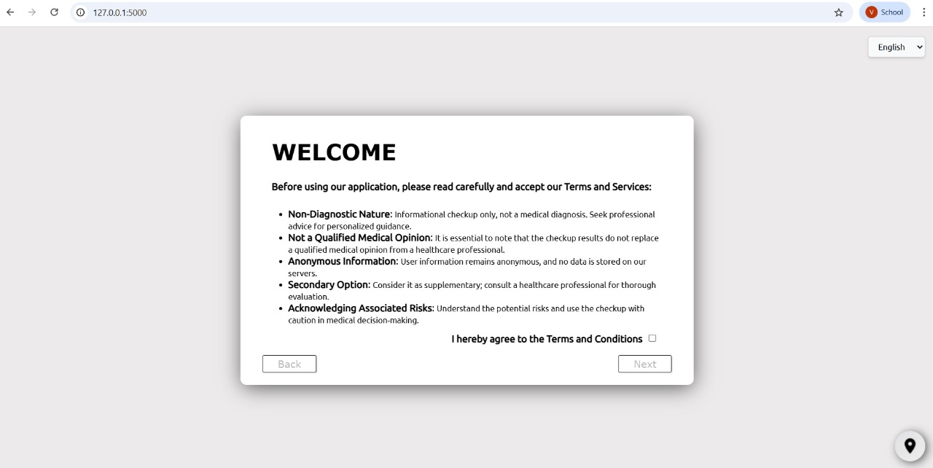
9. Implementation
9.1 Welcome

Slide 18
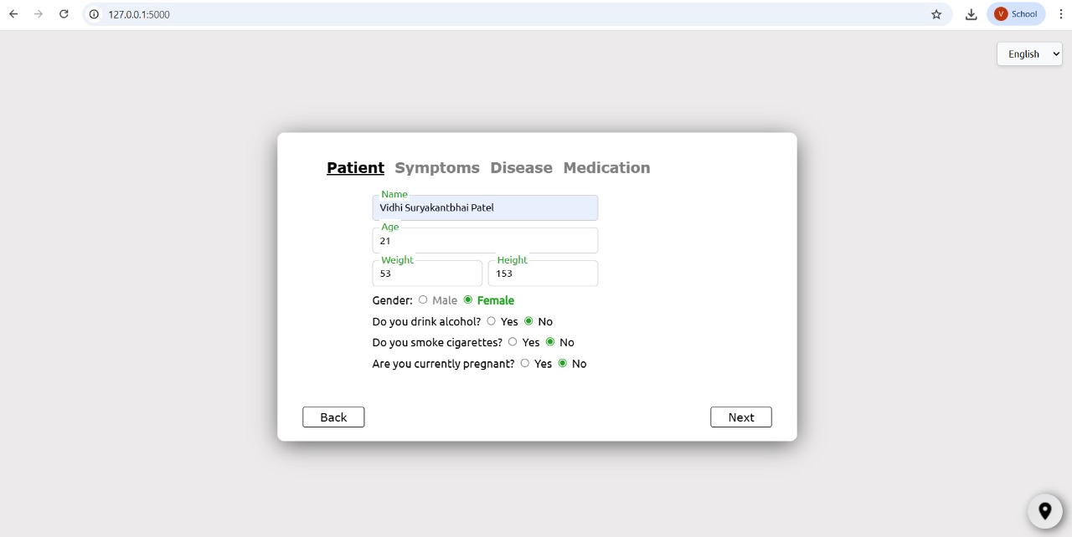
9. Implementation
9.2 User Details Form

Slide 19
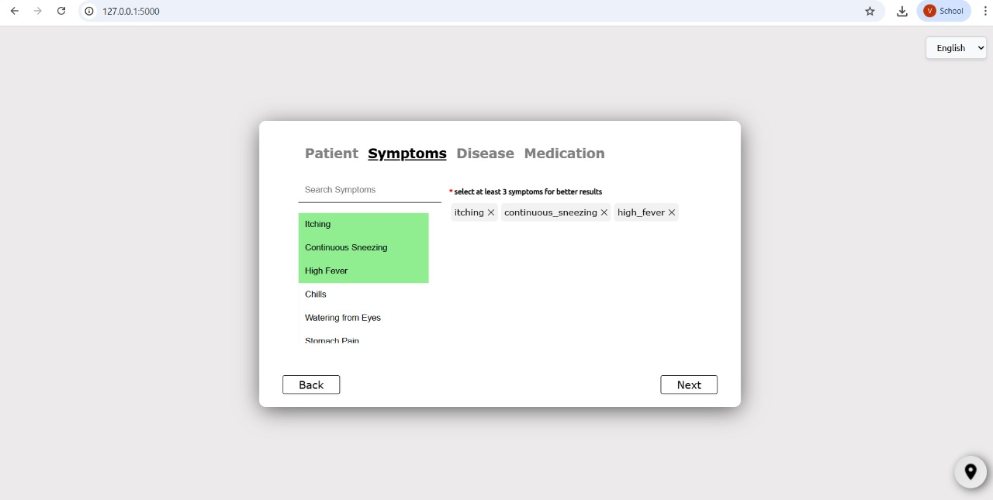
9. Implementation
9.2 User Details Form For symptoms

Slide 20
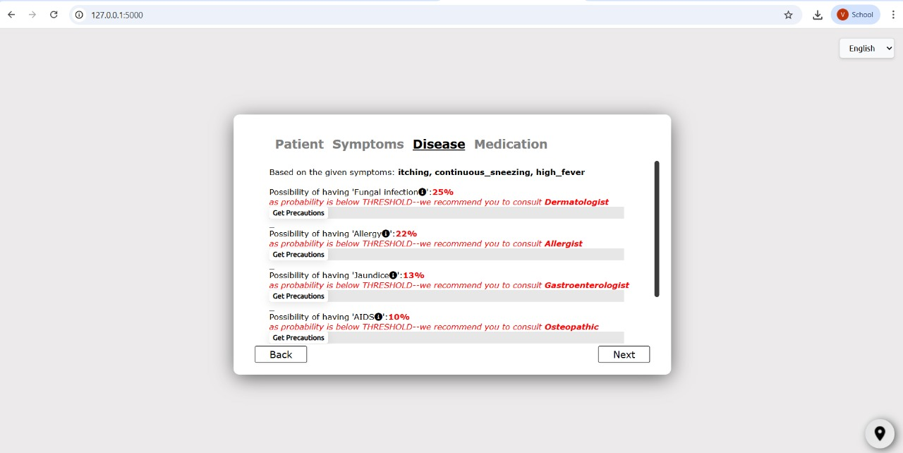
9. Implementation
9.2 Disease Prediction Report

Slide 21
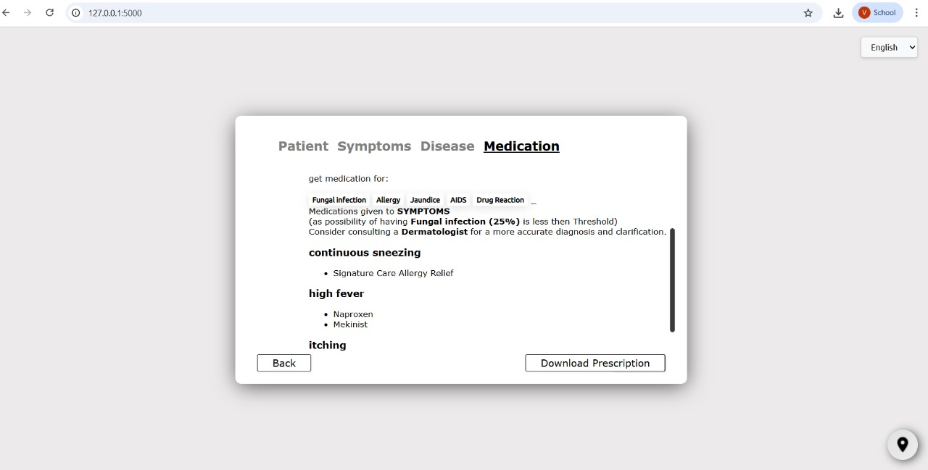
9. Implementation
9.2 Medication

Slide 22
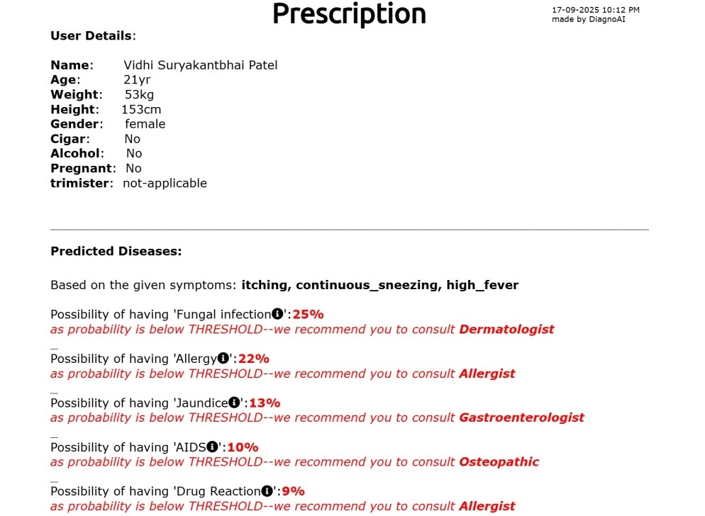
9. Implementation
9.2 Prescription

Slide 23
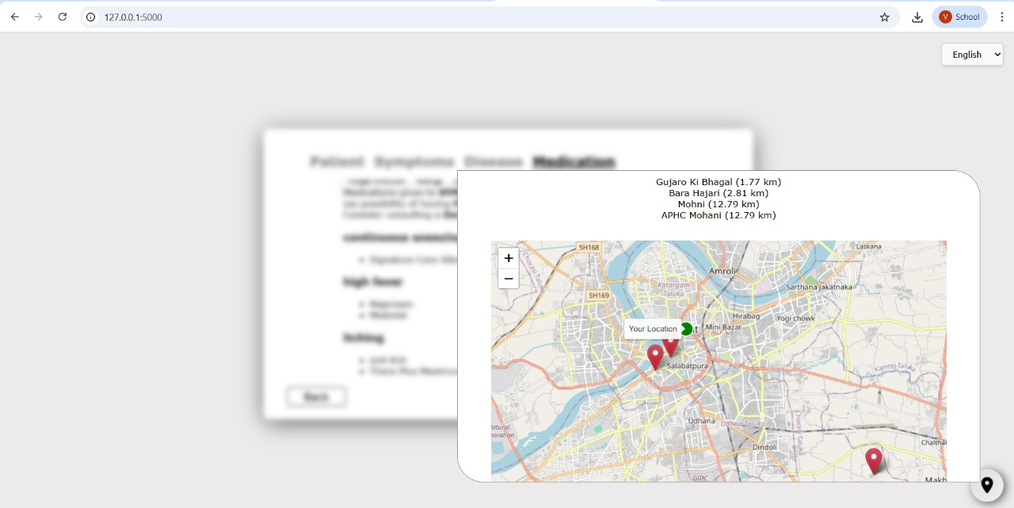
9. Implementation
9.2 Locate Nearby Hospital

Slide 24
9. Implementation
9.2 Reports
9.2.1 Front-End Implementation
The DiagnoAI system uses a clean and user-friendly front-end architecture designed to guide users step-by-step through symptom analysis, personal detail collection, and location identification.HTML5 ensures semantic structure, CSS3 provides responsive layouts across devices, and JavaScript enables interactivity, validations, and real-time processing.
9.2.2 Back-End Implementation
The backend of DiagnoAI handles all major operations required for disease prediction, health report generation, and hospital recommendation. It acts as the core processing unit of the system, connecting the front-end forms with the machine learning model and medical databases.

Slide 25
9. Implementation
Symptom Input Form
Purpose: Allows the user to select or search for their symptoms easily.
Layout & Features:
  Search Bar: A text input field with auto-suggestions that helps users quickly find their symptoms.
  Checkbox List: A scrollable list of common symptoms categorized for better usability (e.g., "Fever", "Cough", "Headache").
  Multi-Selection Support: Users can select multiple symptoms before submission.
  Submit Button: Sends the selected symptoms to the backend for prediction.
  Validation: Ensures that at least one symptom is selected before submission.

Slide 26
9. Implementation
2. User Details Form
Purpose: Collects basic demographic and health-related information to personalize predictions and recommendations.
Layout & Features:
  Personal Information Fields:
    Name (optional – for personalization)
    Age (numeric input with validation)
    Gender (radio buttons or dropdown: Male, Female, Other)
  Health Profile Fields:
    Weight & Height (optional – for BMI calculation and better suggestions)
    Alcohol Consumption: Checkbox or Yes/No option
    Pregnancy Status: Checkbox (shown only if the user selects "Female")
  Form Validation: Ensures all required fields (age, gender) are filled in before proceeding.

Slide 27
9. Implementation
3. Disease Prediction Report
Purpose: Provides the user with a quick overview of potential diseases based on their symptoms.
Layout & Features:
  Header: Displays a title such as "Prediction Results" and a timestamp of when the prediction was generated.
  Top Predictions List:
    Shows the Top 5 Predicted Diseases, ranked in order of probability.
    Each disease is displayed with:
      Disease Name
      Probability Percentage (visualized as a progress bar or percentage number)
      Short Description (one-line explanation of the condition)
      "View Details" Link (navigates to precaution and medication suggestions)
  User-Friendly Display: Use of color coding or icons (e.g., green for mild conditions, red for critical predictions).
  Actionable Options: Buttons to view precautions, get medication advice, or find hospitals directly from this report.

Slide 28
9. Implementation
4. Medication & Precaution Report
Purpose: Offers detailed medical guidance once a disease is selected by the user.
Layout & Features:
  Header Section:
    Displays the Disease Name prominently at the top.
    Shows the Predicted Probability (e.g., 87%) and Recommended Doctor Type (e.g., General Physician, Cardiologist).
  Hospital Visit Status:
    Displays a clear message like:
      "Urgent: Visit hospital immediately"
      "Recommended: See a doctor soon"
      "Optional: Home care sufficient unless symptoms worsen"
    Uses color indicators (Red, Orange, Green) for urgency.
  Medication List:
    Shows a list of recommended medicines (generic names), dosage suggestions, or OTC alternatives.
  Precaution List:
    Displays practical advice for managing the condition (e.g., rest, hydration, avoid allergens).
  PDF Download Option:Allows users to download a prescription-style report containing disease details, medications, and precautions for offline reference.

Slide 29
9. Implementation
5. Hospital List Report
Purpose: Helps users quickly find and navigate to the nearest medical facilities.
Layout & Features:
  Header: Displays "Nearby Hospitals" along with the user’s detected location (or manually entered location).
  Hospital List Table or Card View:
    Hospital Name (clickable for more details)
    Distance from User (in kilometers)
    Address & Contact Number
    "View on Map" Button – opens Google Maps with directions.
  Sorting & Filtering Options: Allows users to sort hospitals by distance or filter by type (e.g., Government, Private).
  Interactive Map (Optional): Displays all hospitals as pins on a map for better visualization.
  Export/Save Option: Users can download or print the hospital list for later use

Slide 30
9. Implementation
9.3 Code Logic (Business Logic)
The DiagnoAI system’s backend is implemented using Python and the Flask microframework, following standard coding practices and modular design principles. The goal is to ensure readability, maintainability, and scalability of the codebase.
1. Data Loading and Initialization
Purpose: To prepare all required datasets and machine learning models at application startup.
Implementation Details:
  CSV Files: The system loads datasets such as:
    disease_precaution.csv (precaution data)
    Hospital_Directory.csv (hospital list with coordinates)
    disease_description.csv (short descriptions for predictions)
  Machine Learning Model: The pre-trained Random Forest Classifier model (.joblib) is loaded once at startup using joblib.load().
  Error Handling: try-except blocks are used to ensure that missing or corrupted files do not crash the application. Instead, user-friendly error messages are logged and displayed when necessary.
  Memory Optimization: Data is stored in global variables only once to avoid reloading during every request, improving performance.

Slide 31
9. Implementation
2. Flask Route Structure
Purpose: To define a clean separation of concerns by mapping each core function to a dedicated route.
Major Routes:
  /send_data
    Handles POST requests from the symptom input form.
    Processes the symptoms, runs predictions, and returns a ranked list of diseases with probabilities in JSON format.
  /displaymedic
    Accepts POST data containing disease name, probability, and user details.
    Calls helper functions to fetch medication info, determine hospital urgency, and return a structured medication and precaution report.
  /locate
    Handles POST requests with location data.
    Uses the Nearest Neighbors algorithm to find and return the nearest hospitals as a JSON response.
RESTful Approach: Routes follow REST conventions, using POST for data submission and JSON responses for compatibility with the frontend.

Slide 32
9. Implementation
3. Helper Functions
Purpose: To encapsulate complex logic, improve code reusability, and keep route handlers simple and readable.
Examples:
  get_medication_info(disease, age, gender)
    Fetches appropriate medication details for the selected disease, considering patient profile.
  suggest_nearest_hospitals(location)
    Uses location coordinates and hospital dataset to calculate distances and return the nearest hospitals.
  getlatlong(location_string)
    Converts manual location input into latitude/longitude coordinates via an API call or geopy library.
  recmedicine(disease)
    Retrieves recommended medications from static data files or external API sources.
Advantages:
  Code readability improves by separating responsibilities.
  Easy maintenance since updates to business logic are localized to individual functions.

Slide 33
9. Implementation
4. Global Variables & State Management
Purpose: To temporarily store data between HTTP requests in this single-user prototype system.
Implementation:
  Variables like response, response1, etc., are used to hold predicted disease data and user session information across multiple routes.
  This approach is sufficient for a prototype or single-user deployment.
Future Improvement (Scalability):
  For a multi-user production environment, these global variables would be replaced with:
    Flask Session Objects or
    A Database (SQLite/MySQL) to persist user-specific data securely and prevent data mix-ups between users.

Slide 34
9. Implementation
5. Coding Standards Followed
PEP8 Compliance: Indentation (4 spaces), descriptive function/variable names, and proper inline comments are used.
Error Handling: Try-except blocks log errors using Python’s logging library.
Modularity: Code is divided into multiple Python files or logical sections (routes, helper functions, data loading).
Version Control: Codebase is maintained under a Git repository (recommended for collaboration and version tracking).

Slide 35
10. Testing
10.1 Strategy
The DiagnoAI system follows a structured Black-Box Testing approach to verify that all user-facing functionalities work as intended, regardless of the internal code structure. The primary goal of this strategy is to validate that the application behaves correctly under various input scenarios, performs reliably across platforms, and provides a smooth user experience.
1. Functional Testing
Objective: To ensure that all features and routes of the system work as expected.
Scope:
  Symptom input and submission process
  /send_data route — verifies that the correct disease predictions and probabilities are returned
  /displaymedic route — verifies that medication, doctor type, and hospital urgency data are correctly displayed
  /locate route — verifies that nearest hospital results are accurate
Method: Test cases are designed with valid, invalid, and edge-case inputs to check if the system produces correct outputs or meaningful error messages.

Slide 36
10. Testing
2. Usability Testing
Objective: To confirm that the application is easy to use, even for non-technical users.
Scope:
  Interface navigation and form clarity
  Visibility of buttons, labels, and messages
  Step-by-step flow from symptom selection → prediction → medication → hospital finder
Method:
  Conducted with a sample group of users from different age groups.
  Observed whether users can complete a task (e.g., find nearby hospitals) without external guidance.
  Collected user feedback and refined the interface based on issues faced.

Slide 37
10. Testing
3. Compatibility Testing
Objective: To ensure that the application functions consistently across various platforms and browsers.
Scope:
  Testing on popular browsers (Chrome, Firefox, Edge, Safari)
  Testing on different devices (desktop, laptop, Android, iOS smartphones)
Method:
  Automated browser testing tools (e.g., Selenium) and manual verification
  Cross-device testing using responsive design checkers to verify layout and form alignment

Slide 38
10. Testing
4. Performance Testing
Objective: To measure system responsiveness and reliability under normal and high usage.
Scope:
  Model prediction response time
  External API call response time (Google Maps, FDA API)
  Page loading speed and hospital list rendering
Method:
  Simulated multiple symptom submissions and location requests concurrently
  Used tools like Postman and JMeter to measure response times and check for bottlenecks

Slide 39
10. Testing
5. Internationalization (i18n) Testing
Objective: To verify that the multilingual support works correctly and translations are applied everywhere.
Scope:
  Switching languages dynamically (English → Hindi → Gujarati, etc.)
  Ensuring that all labels, buttons, alerts, and reports are translated
  Checking that layout does not break due to longer translated text
Method:
  Manual verification of translated pages
  Validation that no untranslated text or hard-coded strings remain in the UI

Slide 40
10. Testing
10.2 Test Cases
  TC-01 — Load Welcome Page
  TC-02 — Enter User Details (Name, Age, Gender, Contact)
  TC-03 — Validate User Details (Required Fields / Invalid Inputs)
  TC-04 — Navigate to Symptoms Page
  TC-05 — Select Symptoms from List
  TC-06 — Add / Remove Selected Symptoms
  TC-07 — Submit Symptoms for Analysis
  TC-08 — Display Predicted Disease Based on Symptoms
  TC-09 — Validate Correct Mapping of Symptoms → Disease
  TC-10 — Show Recommended Medication for Predicted Disease
  TC-11 — Generate User Prescription (PDF / On-Screen)
  TC-12 — Download / Save Prescription
  TC-13 — Find Nearby Hospitals / Clinics on Map
  TC-14 — Fetch Accurate Location Using GPS / Input Address
  TC-15 — Display Map Markers for Nearby Health Centers
  TC-16 — Open Directions for Selected Hospital / Clinic

Slide 41
11. Future Enhancement
User Profiles & History Tracking
Doctor Appointment Booking System
Predictive Health Analytics
Advanced AI Model Integration
Mobile App Version
Chatbot-Based Symptom Input
Admin Dashboard

Slide 42
12. Bibliography
Flask Documentation – A microframework for Python
Official Documentation. Accessed from: https://flask.palletsprojects.com/
Description: Provides comprehensive information on Flask, a lightweight Python web framework used for building web applications and APIs.
Scikit-learn – Machine Learning in Python
Official Documentation. Accessed from: https://scikit-learn.org/
Description: Documentation for scikit-learn, a Python library for machine learning, including classification, regression, clustering, and model evaluation.
Pandas – Python Data Analysis Library
Official Documentation. Accessed from: https://pandas.pydata.org/
Description: Provides detailed guidance on using pandas for data manipulation, analysis, and handling structured data in Python.
OpenFDA API Documentation
U.S. Food & Drug Administration. Accessed from: https://open.fda.gov/apis/
Description: Documentation for the OpenFDA API, which allows access to public FDA data including drugs, devices, and adverse events.

Slide 43
12. Bibliography
Geopy Documentation
A Python Geocoding Toolbox. Accessed from: https://geopy.readthedocs.io/
Description: Provides instructions for using Geopy, a Python library for geocoding, reverse geocoding, and working with geographic coordinates.
Flask-Babel Documentation
Babel Extension for Flask. Accessed from: https://pythonhosted.org/Flask-Babel/
Description: Guides the implementation of internationalization (i18n) and localization (l10n) features in Flask applications.
Pressman, Roger S. Software Engineering: A Practitioner’s Approach, McGraw-Hill.
Description: A widely recognized textbook covering software engineering principles, methodologies, and best practices for application development.
Sommerville, Ian. Software Engineering (10th Edition), Pearson Education, 2015.
Description: Comprehensive guide on software engineering processes, including software development life cycle, design, testing, and maintenance

Slide 44
THANK
YOU

